Slide 1

Promoting Quality Education using the Good School Toolkit, Experience from Uganda
2nd November 2023
Hassan Muluusi
Technical Advisor
Notes:
About Raising Voices:
Working towards the prevention of VAC and VAW in Uganda
Strive to influence power dynamics shaping relationships

Slide 2
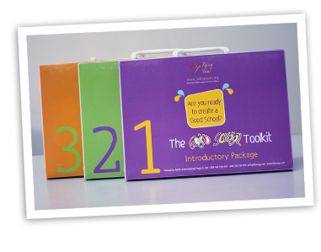
1. The GST takes a whole school approach
2. Led by
  2 Teacher Protagonists
  2 Students
  2 Parents
  Sub-committees, administration, community
3. Six-step process for creating Good Schools
4. Four Entry Points
  Teacher-Student relationship
  Peer-to-peer relationships
  Teacher/Student relationship to the school
  Parent/community relationship to school
Good School Toolkit

Slide 3
Objectives of the Good school toolkit
To increase learners’ confidence and success through creating an enabling experience of school
To create a safe and respectful learning environment
To strengthen school administration responsiveness to the needs of all stakeholders.

Slide 4
Good school toolkit as a Whole school approach
Engage at multiple layers of influence flowing through the ecological framework surrounding the learner
  School administration,
  Teaching & non-teaching staff,
  Students,
  Community members,
  External policy makers

Slide 5

37
Notes:
Whole school approach aims to create an enabling operational culture. This focus is on:
Policy climate
School systems
Vision and attitude of school administration, teachers, parents and learners
Social norms
Life experience of children

Slide 6
Lessons learned
Violence in schools is preventable in a short run.
Focus on beliefs, norms and practices that influence the school eco-systems.
Schools must be at the core of change- all stakeholders must participate.
Effective interventions must address the conditions at school, society and community levels that influence children’s experience of schools
Schools need to establish school wide mechanisms, structures, policies and systems for ensuring children’s safety at school

Slide 7





Moving Forward
Strengthen implementation
in 1,000 Schools
GST Agile +
5,000 Schools Project
with Ministry of Education
Leveraging technology
GS Mobile App

Slide 8
Thank you

